Slide 1
Chapter 1: Objects and Classes
Professor Brandon Pugh

Slide 2
Open Textbook Collaborative
https://bit.ly/OpenTextCollabNJ
A New Jersey Higher Education OER Project funded in 2020 through the Fund for the Improvement of Postsecondary Education for the Open Textbooks Pilot Program, U.S. Department of Education

Slide 3
Introduction
Concepts:
Objects
Classes
Methods
Parameters

Slide 4
Objects and Classes
Everyone go and grab something around your room/area

Slide 5
Detail, Detail, Detail!
Using that object we are going to be doing the classwork for this week together.
What is your object?
What are some unique things that make it what it is?

Slide 6
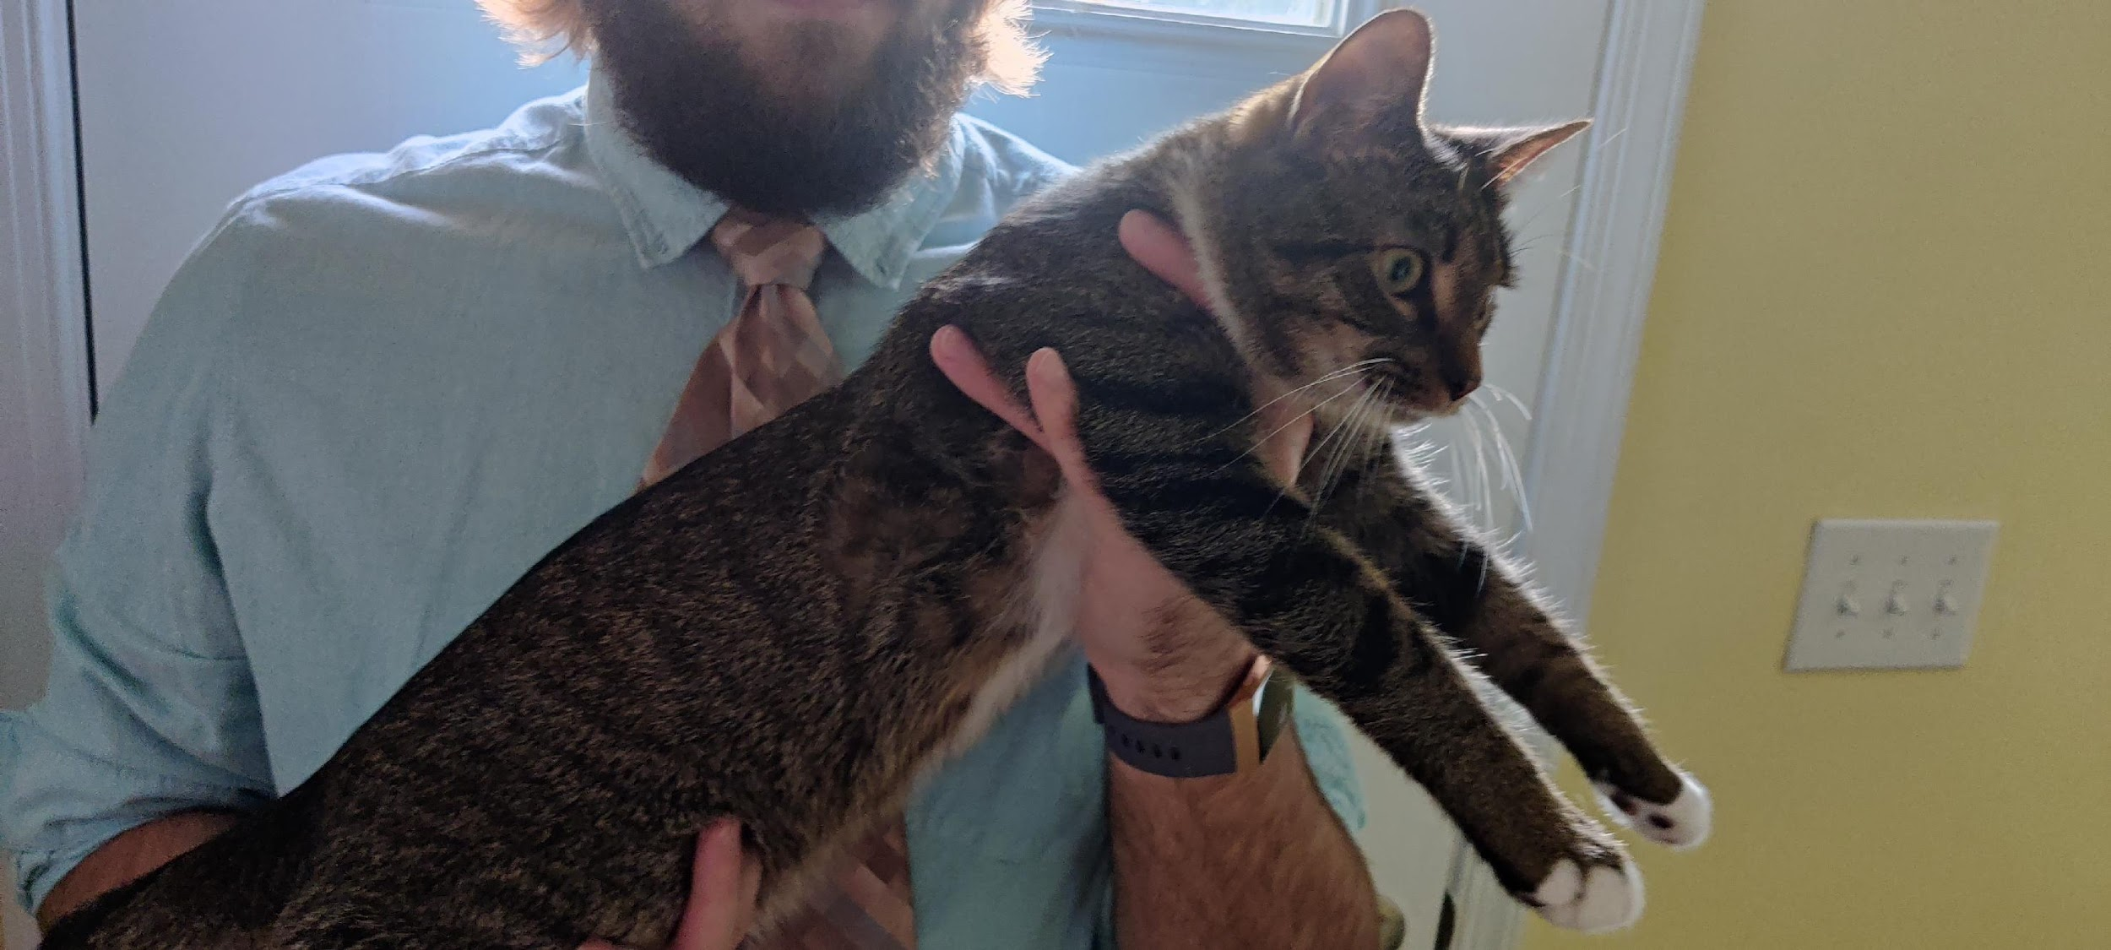
Cat #1

Slide 7
Cat #2

Slide 8
Class Example
Blueprint for objects
Car, Phone, Class, Student, Animal, the options are endless!
Creates Objects or “Instances”

Slide 9
Object Example
Objects are derived from classes
Using example on previous slide, we can get more specific with our classes
Car Object = MyCar (it’s red, Chrysler, 4 door, etc)
Phone Object = Android (One Note, silver, storage size, USB-c)
Try out writing out what your class would be with the object that you picked up ealier!

Slide 10
Methods
Objects have Methods which can be invoked
An example of this using the Cat I mentioned earlier would be Meow()
This would be an action that the Cat objects have
Any methods in a class will be present in any object made
Methods are followed by two parenthesis that contain the parameters

Slide 11
Parameters
Parameters are used to pass additional information to a method
If you are using something to name an object, you could see something like this setName(String name)
This means that a String is required to invoke the method

Slide 12
Data Types
Every variable has a type
A name is most likely a String (text value)
A height is most likely an int (number value)
A yes or no answer is a Boolean value (True or False)

Slide 13
Lets Practice!
We’re going to create a person class
(Will be uploaded to Blackboard afterwards)

